Slide 1

Air
Stage 1
Table Quiz

Slide 2
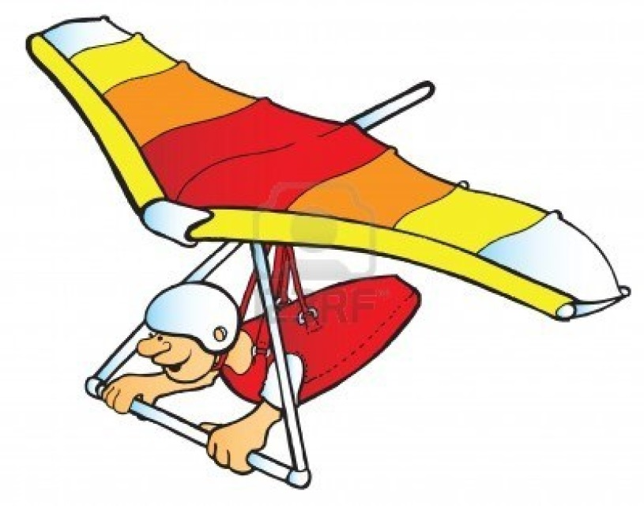
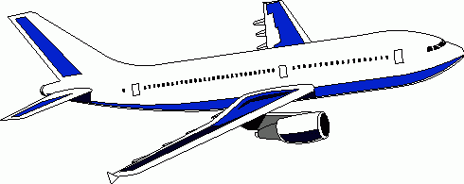
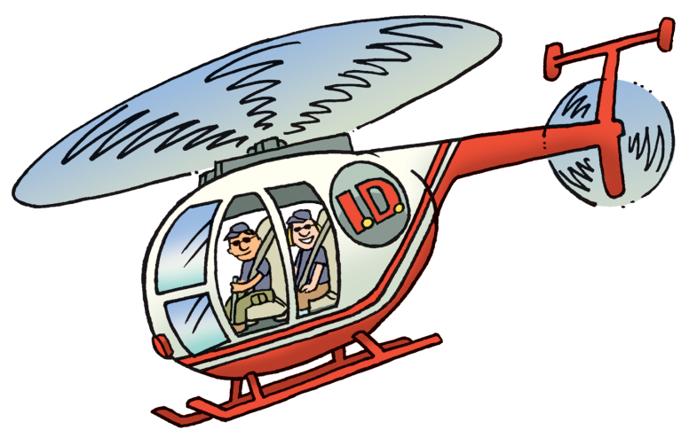
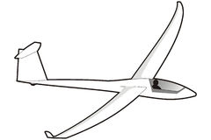
Name each of these things that fly
1 2
3 4

Slide 3
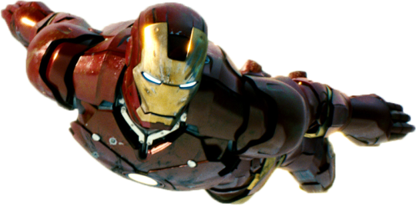
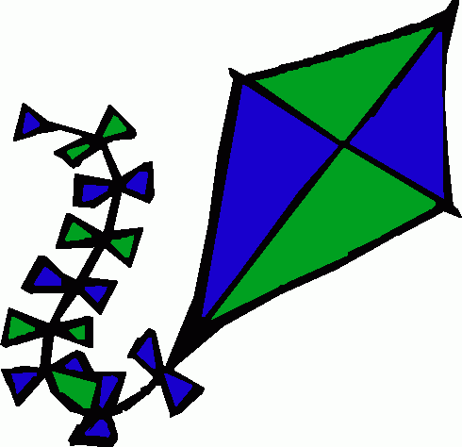

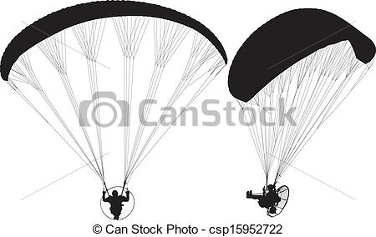
Name each of these things that fly
5 6
7 8

Slide 4
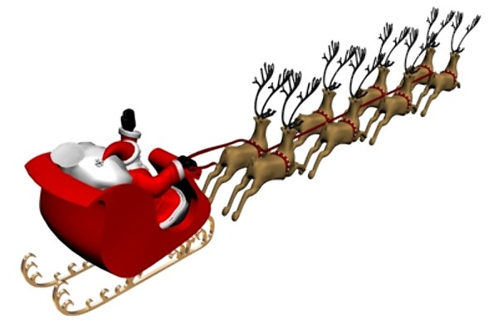
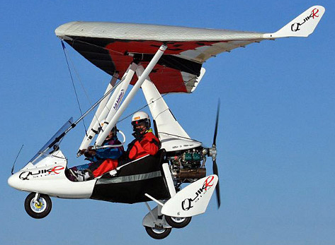
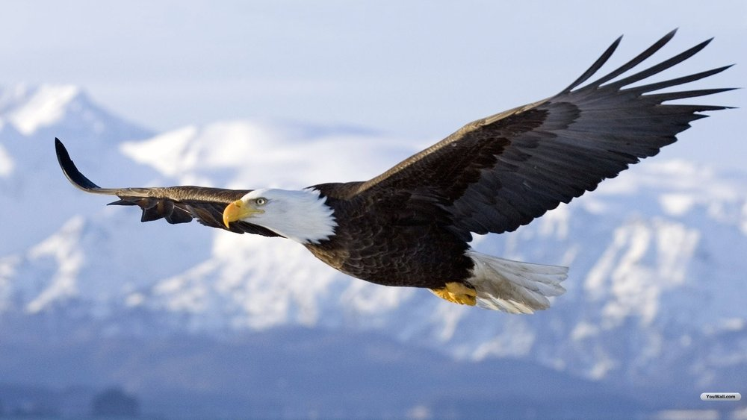
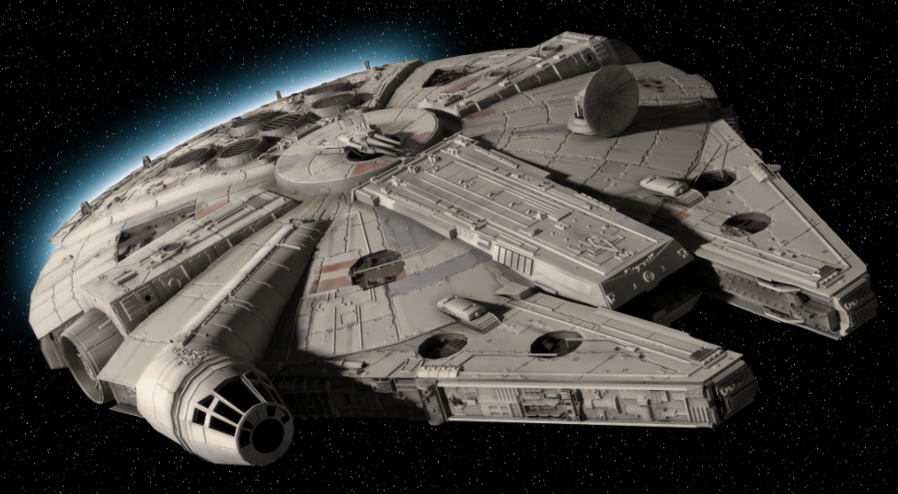
Name each of these things that fly
1 2
3 4

Slide 5
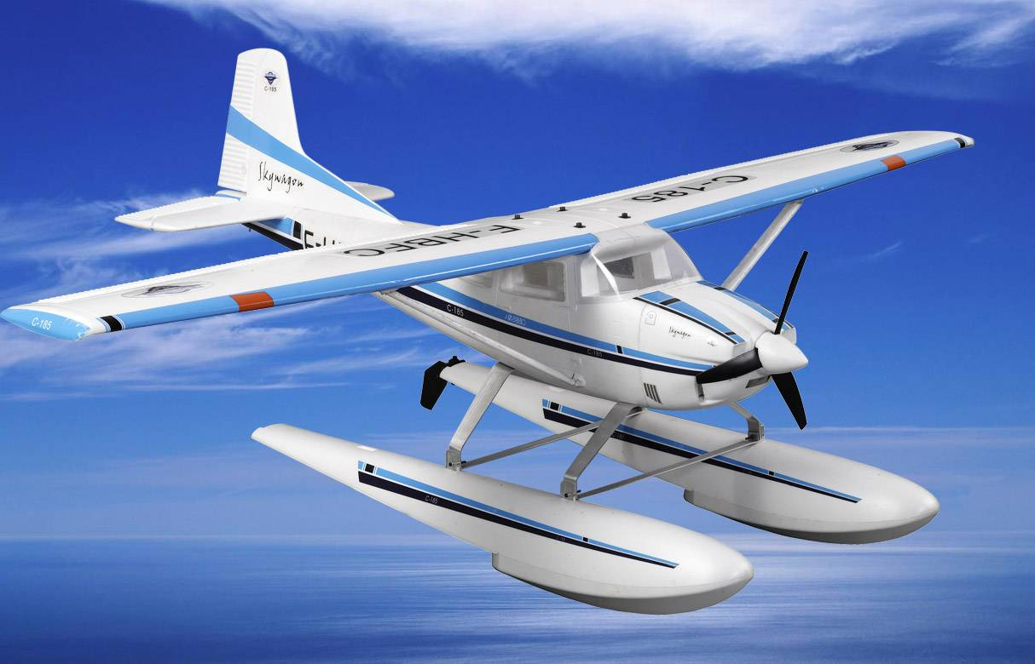
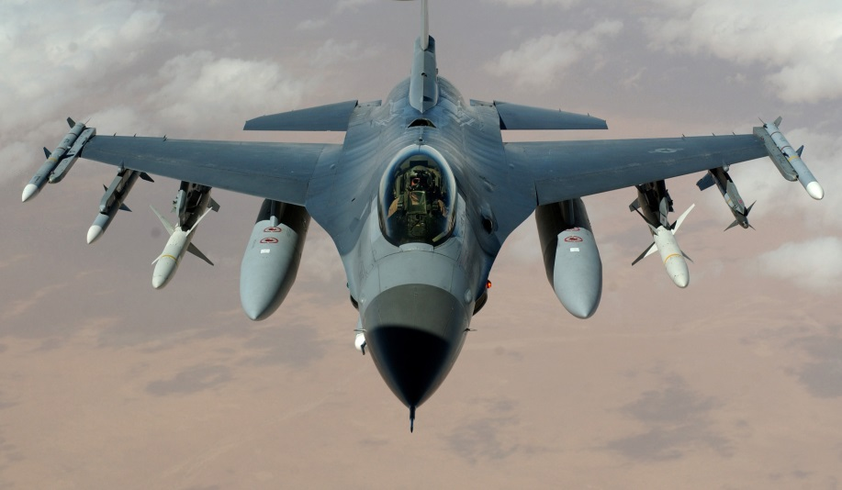
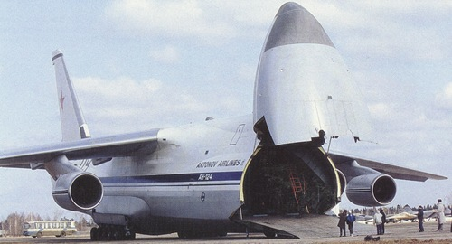
What’s the main use for each of these planes?
5 6
7 8

Slide 6
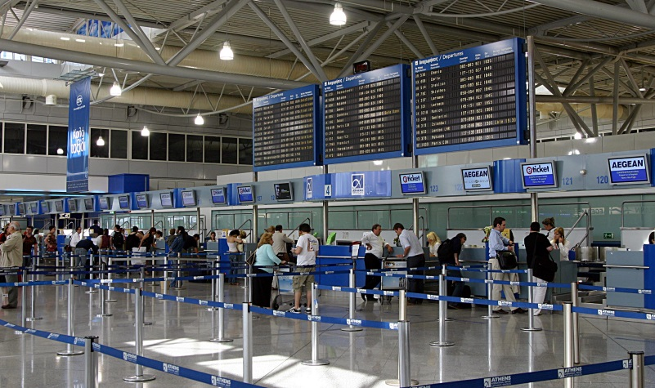
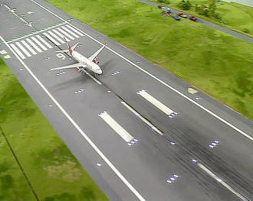
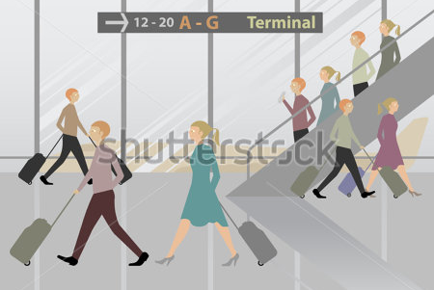
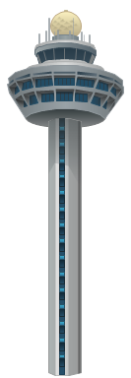
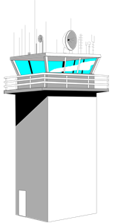
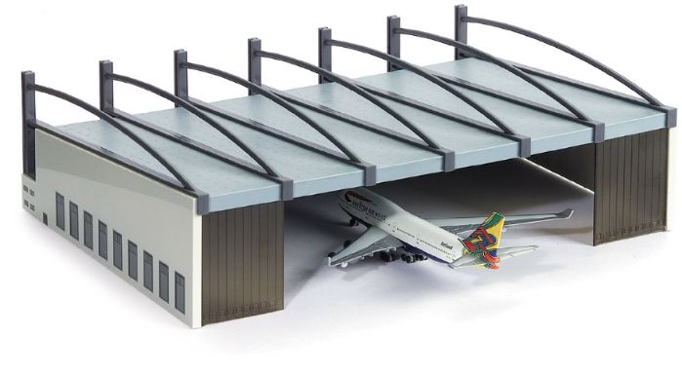
Name these key airport features?
1 2
3 4

Slide 7
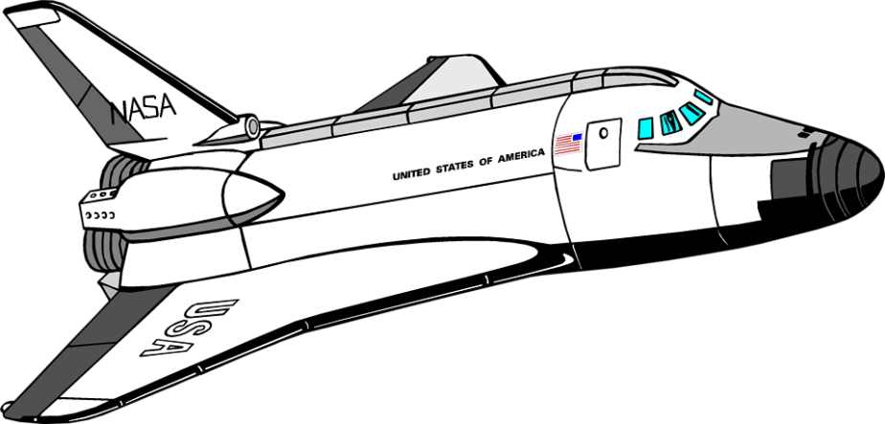
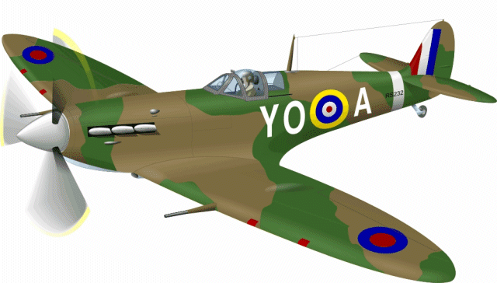
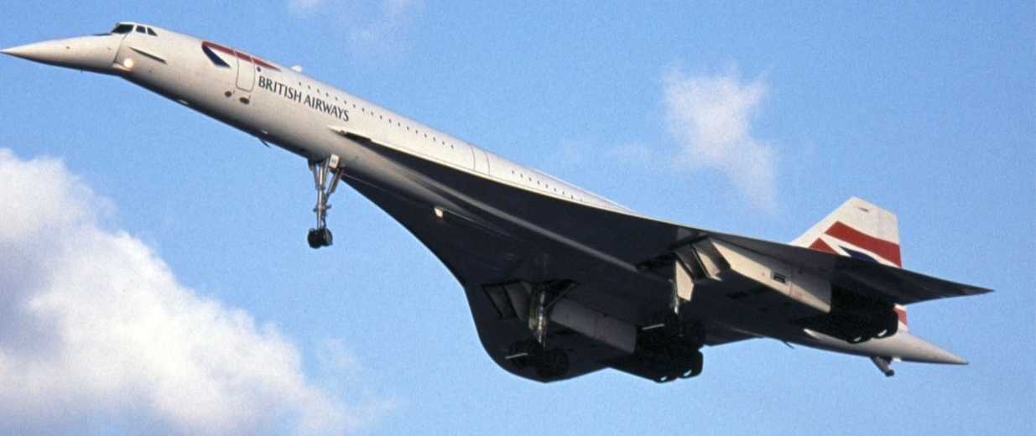
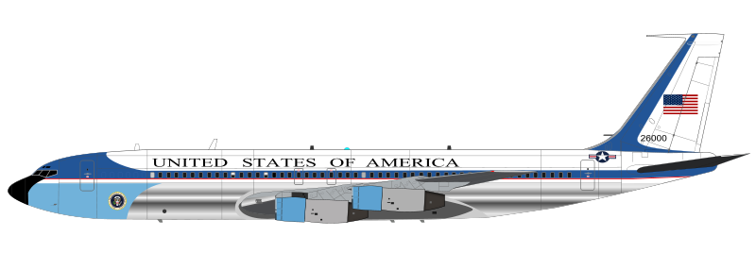
Name each of these famous planes
5
6
7
8

Slide 8
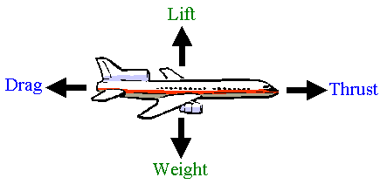
The Four Forces for Flight
Label each direction with the correct force:
DRAG
LIFT
THRUST
WEIGHT
?
?
?
?

Slide 11
Answers

Slide 12
Name each of these things that fly
1 2
3 4
Plane
Hang Glider
Glider
Helicopter

Slide 13
Name each of these things that fly
5 6
7 8
Ironman
Kite
Hot-Air Balloon
Paraglider

Slide 14
Name each of these things that fly
1 2
3 4
Santa
Micro-lite
Eagle or Bird
Millennium Falcon

Slide 15
What’s the main use for each of these planes?
5 6
7 8
Carrying passengers
Landing on water
Carrying very large loads
Fighter jet

Slide 16
Name these key airport features?
1 2
3 4
terminal
runway
control tower
hanger

Slide 17
Name each of these famous planes
Spitfire
5
6
7
8
Space Shuttle
AirForce One
Concorde

Slide 18
The Four Forces for Flight
Label each direction with the correct force:
DRAG
LIFT
THRUST
WEIGHT
?
?
?
?

Slide 19
Lift
Thrust
Drag
Weight

